Slide 1
Ball and person detection by color detection
Waseda University, 4th, School of Fundamental Science and Engineering, Department of Information Science and Engineering
Keishin Asakura
1
Notes:
I will talk about my research on ball and person detection by color detection.

Slide 2
The goal of this research
Detecting people and ball
in a soccer match
to determine ball possession
2
Notes:
The goal of this research is to detect people and a ball in a soccer match to determine ball possession.

Slide 3
Deliverables
Ball detection
Detect the colors of
the uniforms of each of the two teams
3
Notes:
In brief summary, I was able to detect the ball and each of the two colored uniforms.

Slide 4
・Introduction
・Methods
・Results
・Discussion
・Conclusion
4
Notes:
The following is the sequence: Introduction, Methods, Results, Discussion, and Conclusion.

Slide 5
Introduction
Soccer
Object
detection
↑My favorite sport
5
Notes:
I like soccer and in modern soccer you can get different information like number of passes, number of shots in real time. It can also calculate attack patterns and ball possession to help teams score and win. Deep learning is used for those. I started this research because I wanted to know how the field I am studying is used in the sports I love. I had never studied deep learning or anything like object detection, so I used opencv as a basis for object detection.

Slide 6
Methods
1. Frame the video piece by piece.
2. Converted to gray image
3. Blurring and Smoothing
4. Binarization
5. Obtain contours
6. Detection color specification
6
Notes:
Next, the methods are introduced.
1. Frame the video piece by piece.
2. Converted to gray image
3. Blurring and Smoothing
4. Binarization
5. Obtain contours
6. Detection color specification

Slide 7
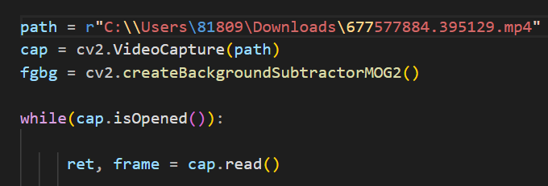
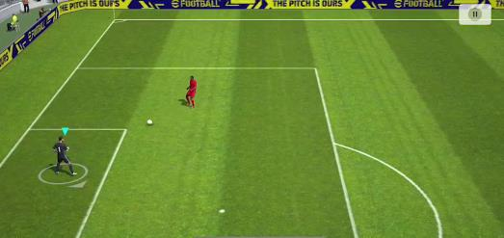
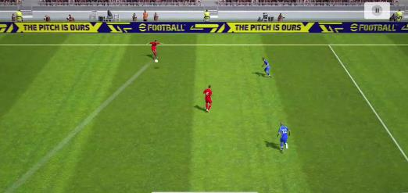
1. Frame the video piece by piece
Frame 1
VideoCapture(path), cap.read()
Get camera frame
Frames are animated
with a while statement.
Frame 10
7
Notes:
First, the video was divided into individual frames.
I got the video with videocapture() and read each frame with cap.read.().
The top image is the first frame and the bottom image is the 10th frame.

Slide 8
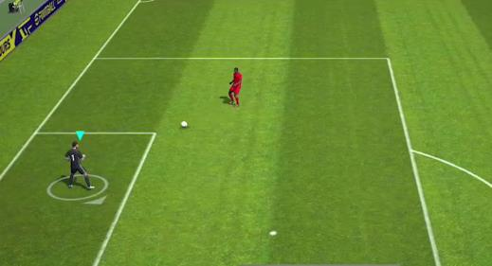
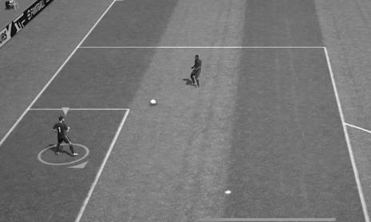
2. Converted to gray image
cvtColor() → Converts the color of an image
cvtColor()
8
Notes:
Second, the color image is changed to a gray image. This is necessary for the binarization to be performed later.

Slide 9
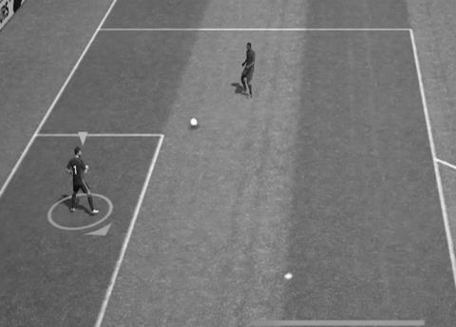
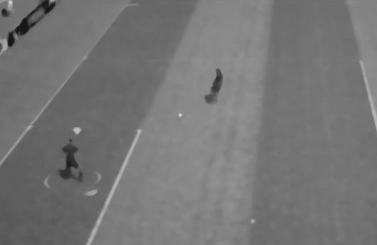
3. Blurring and Smoothing
medianBlur()→Effective against specific noise
medianBlur()
Blur()→平均
Gray Image
Blurred and smoothed image
9
Notes:
Next, smoothing and blurring were performed. In this case, we used the median blur method, which takes the median value and blurs it, but there are other types of blurring, such as Gaussian blurring and normal blurring. Also, blurring enables any peculiar noise or obstructions to eliminate.

Slide 10
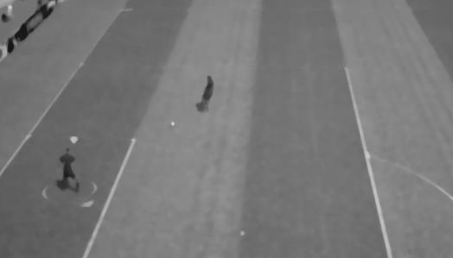
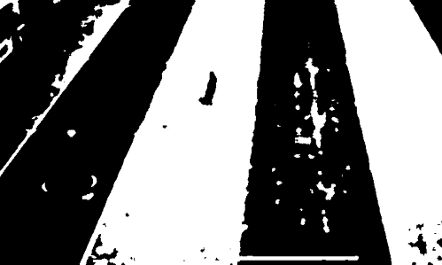
4. Binarization
threshold()→Conversion process to two shades of black and white
If the value of a pixel is greater than
the fighting value (200 in this case), it is converted to white.
threshold()
Blurred and smoothed images
Binarization
10
Notes:
At the end of the preprocessing, binarization was performed using the THRESHOLD function. The operation then clarifies the boundaries of the object to be processed, which is useful for the next step of contour extraction.

Slide 11
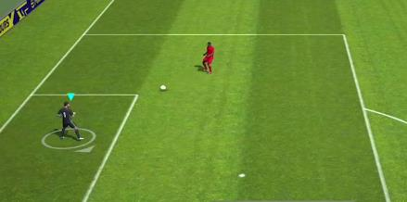
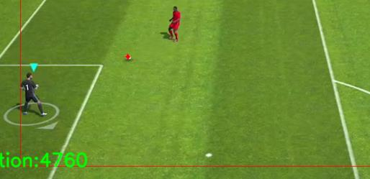
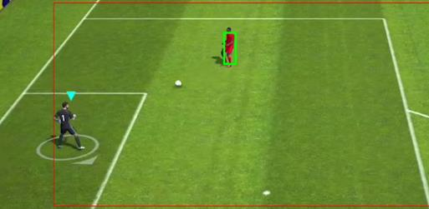
5. Obtain contours
boundingRect()
→ Calculate the rectangle
circumscribed to the contour
minEnclosingCircle()
→ Calculate the smallest
circumscribed circle of the contour
11
Notes:
As post-processing, the area of the contour was calculated, and each detected object was colored so that it can be identified as a ball or a person. The area was then specified so that other obstacles have no detection.

Slide 12
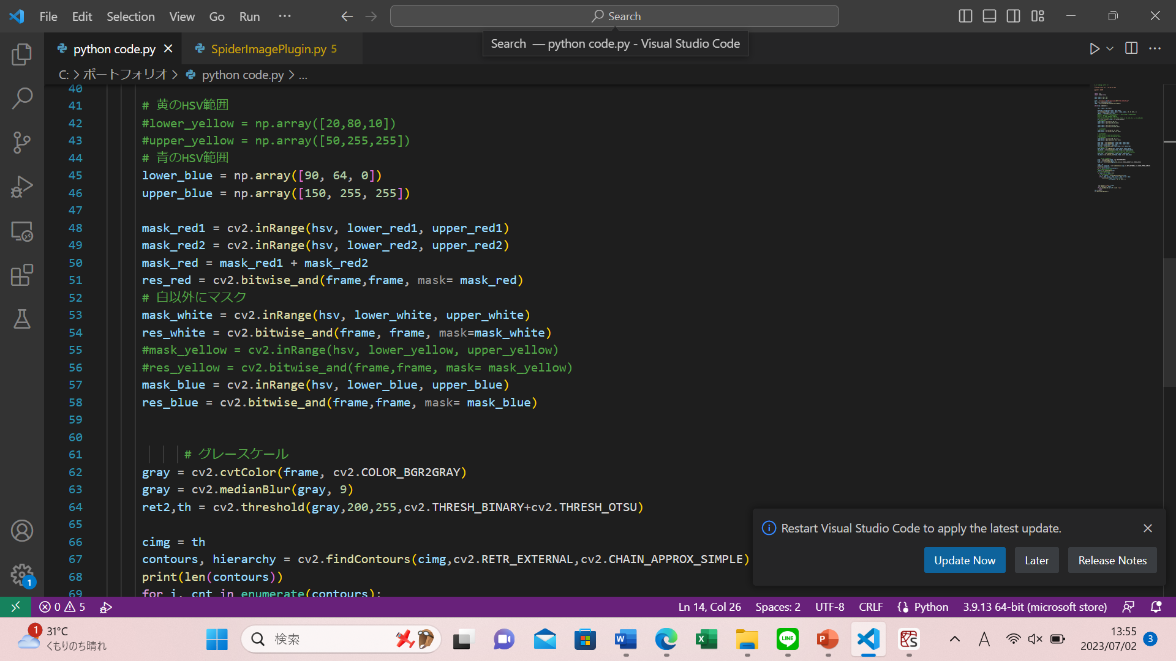
6. Detection color specification
inRange()→ Extract specific colors from an image
betwise_and()→Image obtained with the inRange function
covered by the original image
12
Notes:
The color detection method used RGB image data and the inRange function, which is used to extract a specific color range, and applies the bitwise_and function, a method of image processing.

Slide 13
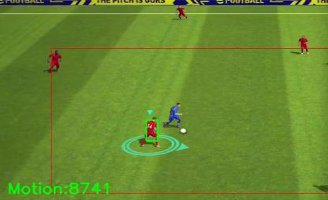
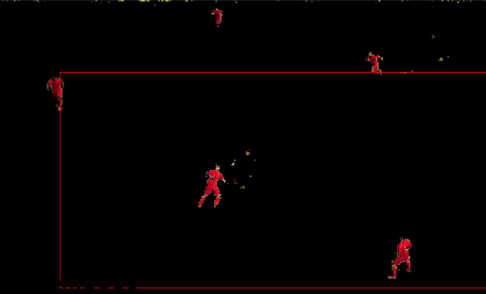
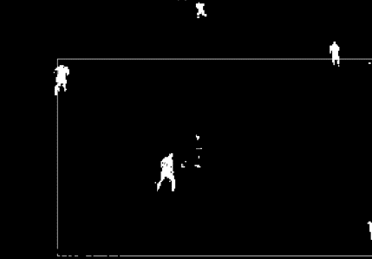
Original image
betwise_and function
inRange function
13
Notes:
For a concrete example, consider the case of extracting the region of a person wearing a red uniform. First, RGB image data is prepared, and the inRange function is applied to extract a specific color range. In the resulting black-and-white image, white pixels represent the area of the red uniform, and other areas are black. Next, the original RGB image data and the extracted black-and-white image are combined using the bitwise_and function. This process produces the effect that all but certain areas of the original image are covered up and only the person in the red uniform emerges.

Slide 14
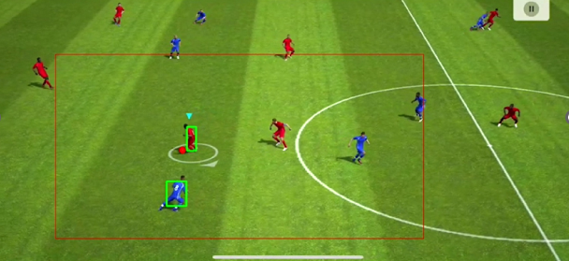
Results
14
Notes:
In this way, the detection was performed with a narrower detection range on the screen. Ball was filled in red and people were surrounded by green. We are able to detect balls and people at the same time, but not all at the same time.

Slide 15
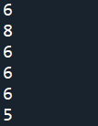

Blur Comparison
Number of contours(per frame)
medianBlur()
GaussianBlur()
15
Notes:
Also, the blurring method used is one crucial finding. We discover that the median Blur function yielded superior results with fewer false detections compared to Gaussian Blur. Median Blur is particularly effective in handling images with salt-and-pepper noise.

Slide 16
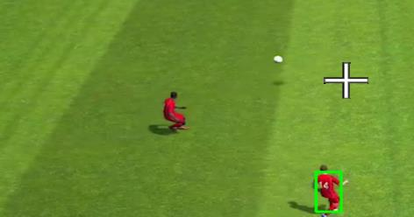
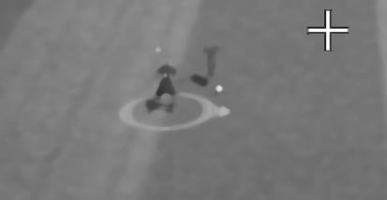
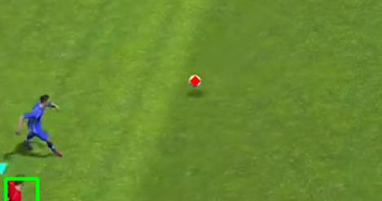
Discussion
Difficult to detect
when the body is
lying on its side
Blurred and smoothed image
Color image
16
Notes:
The results indicate that occasionally missed detections and challenges related to specific orientations or distances are encountered. Based on the observations of this study, some predictions also arise. While visually obvious, it has been noted that bodies facing sideways are often in shadow, making detection more difficult.

Slide 17
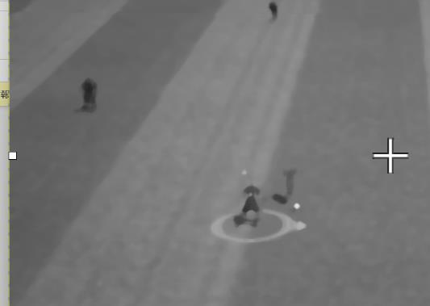
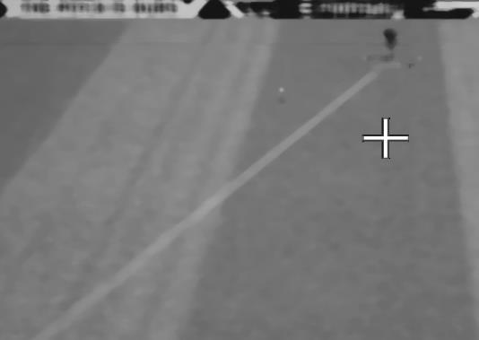
Difficult to detect ball
when far from camera
Close distance from camera
Distant distance from camera
17
Notes:
In addition, balls that are located at a significant distance from the camera or in a floating position may be more difficult to detect accurately. Maybe, adjustments to pre-processing and post-processing techniques can minimize false positives and improve overall detection performance.

Slide 18
Conclusion
1. Obstacle removal
2. Object detection
3. Identification by color detection
18
Notes:
Object detection was divided into three steps: first, obstacle removal and preparation to do object detection; second, object detection; third, identification of people and balls by color detection.

Slide 19
To achieve my goals
Determine which color team is
closer to the ball
Count every frame
19
Notes:
As a future work, if we determine which team is closer to the ball and judge it every frame, we can determine the percentage of ball possession.

Slide 20
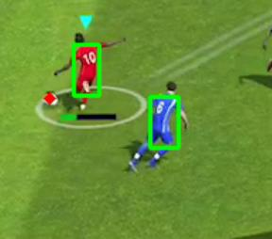
In this case…
Red is closer.
Red←+1 count
Blue←0 count
Perform this operation for the total number of frames
20
Notes:
For example, in this case, the red team is closer to the ball, so +1 count.

Slide 21
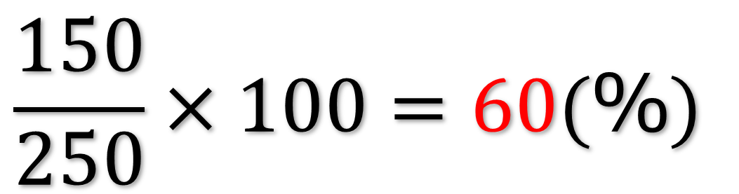
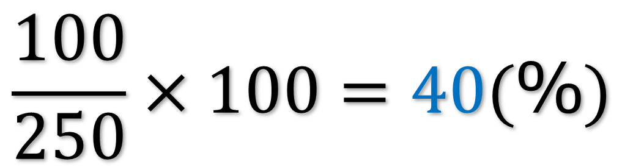
Ex. Total number of frames is 250
$$\frac{150}{250}×100=60(％)$$
Red:150 counts
$$\frac{100}{250}×100=40(％)$$
Blue:100 counts
21
Notes:
A decision is made in each frame, and the count is divided by the total number of frames to obtain the percentage of ball possession.

Slide 22
Reference
Alan D and Diego M: Automatically measuring
soccer ball possession with AI and video analytics, 2022.
Automatically measuring soccer ball possession with AI and video analytics | Tryolabs
22
Notes:
ガウスの説明median Blur function, which performs median smoothing based on the distance from the kernel's center,
Gaussian Blur (Figure 2), which applies blur based on the kernel's central point.
どのように調整したかThe area to be contour acquired was specified. Smaller areas result in more false positives.
将来どういかされるかI think we can get real-time information by combining deep learning with the research we have done here.
I can’t listen to your question.
なぜ色検出を選んだか
I had never studied deep learning before, and it was relatively easy for me to start learning because it was so simple.
研究で難しかったこと、
It was difficult to remove obstacles such as spectators and white lines by color detection. This is because the color of the ball and the white line are the same.
どのように解決したか
To solve this problem, we narrowed the range of object detection and solved the problem.

